Slide 1



OPEN LEDGER USING BLOCKCHAIN
PRESENTED BY:
PRAJWAL CHHETRI
SACHI KAMAT
ANUJ TIMSINA
SANDIP THAPA

Slide 2
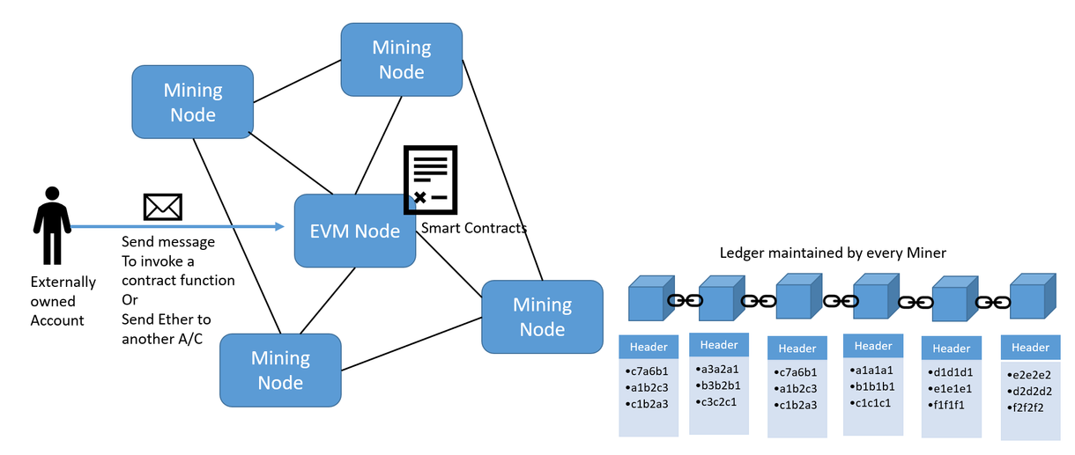
WHAT IS BLOCKCHAIN ?
Blockchain technology is defined as a decentralized, distributed ledger that records the origin of a digital asset.
Every block includes a timestamp and a hash of the previous block in order to make it further resistant to manipulation.

Slide 3

USER
USER
query
BLOCKCHAIN NETWORK
query
GENESIS
BLOCK
BLOCK
1
BLOCK
2
BLOCK
N
BLOCK
4
BLOCK
3
query
query
USER
USER

Slide 4
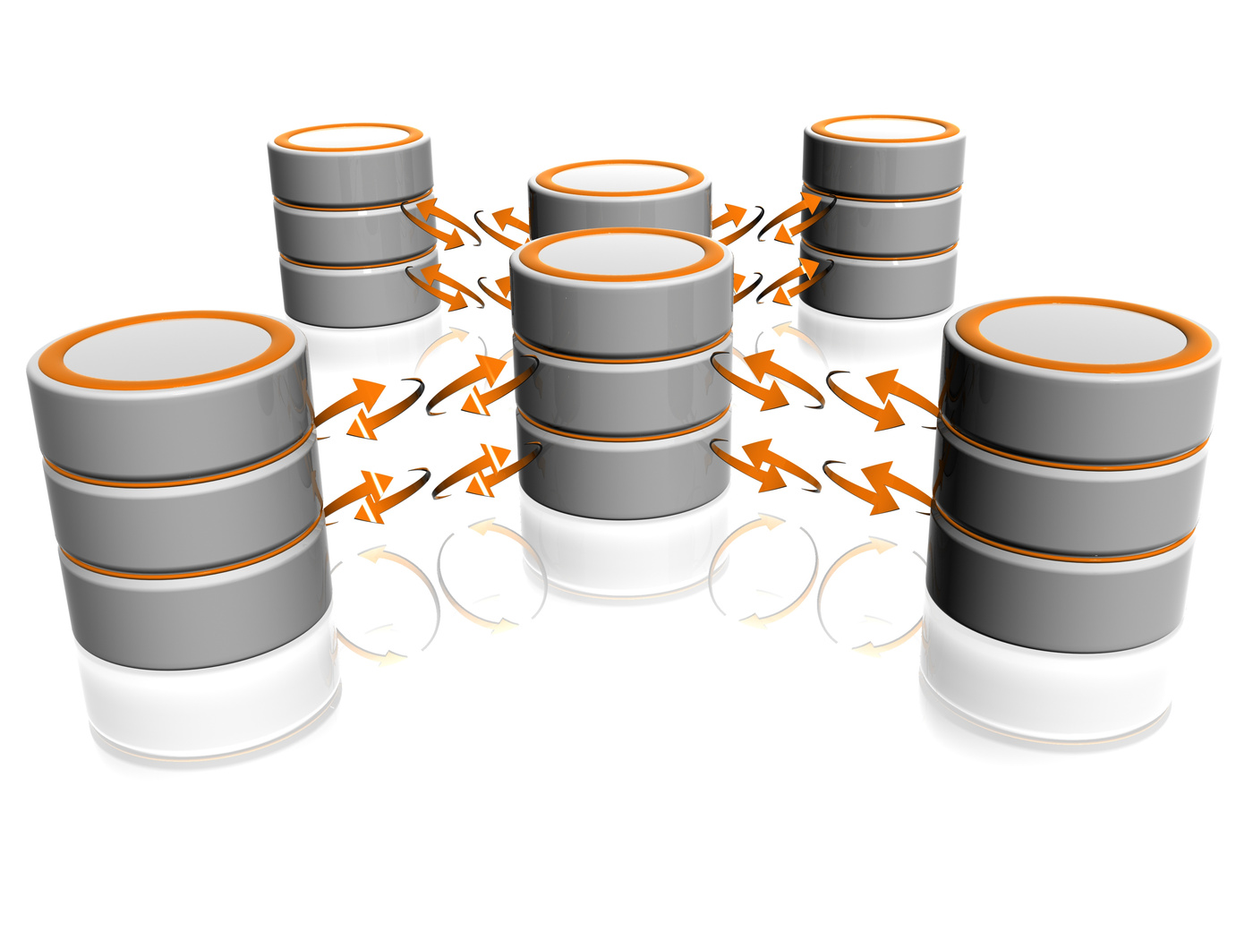
Decentralization
database is dispersed across multiple servers.
every node makes its own decision.
peer-to-peer architecture
immutable

Slide 5
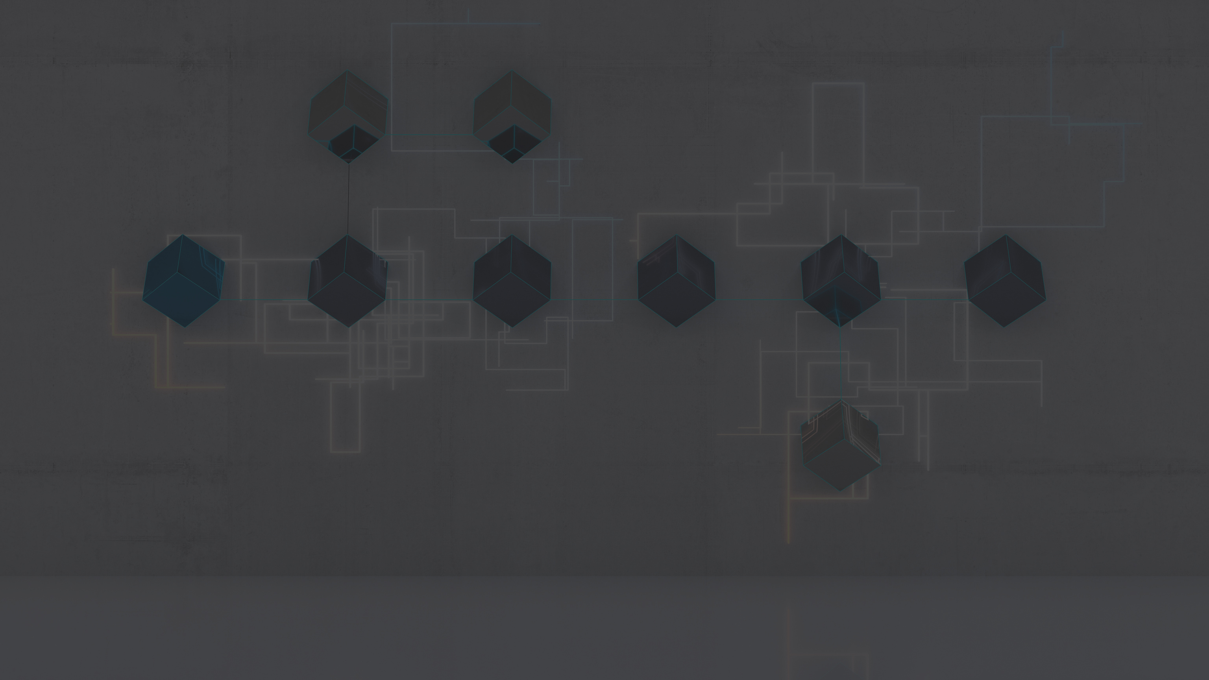

BLOCKCHAIN REAL WORLD APPLICATIONS
Digital ID
Healthcare
Wills or inheritances
Food Safety
Digital Voting
Data Sharing
Weapons Tracking

Slide 6
Features
Immutability
Decentralized
Enhanced Security
Distributed Ledgers
Consensus
Faster Settlement

Slide 7
WHY BLOCKCHAIN ?
Besides the others features provided by blockchain our project mostly focuses on :
Transparency
Immutability

Slide 8
To make government contracts transparent to the public by creating a public database of the records using blockchain.
CONCEPT

Slide 9
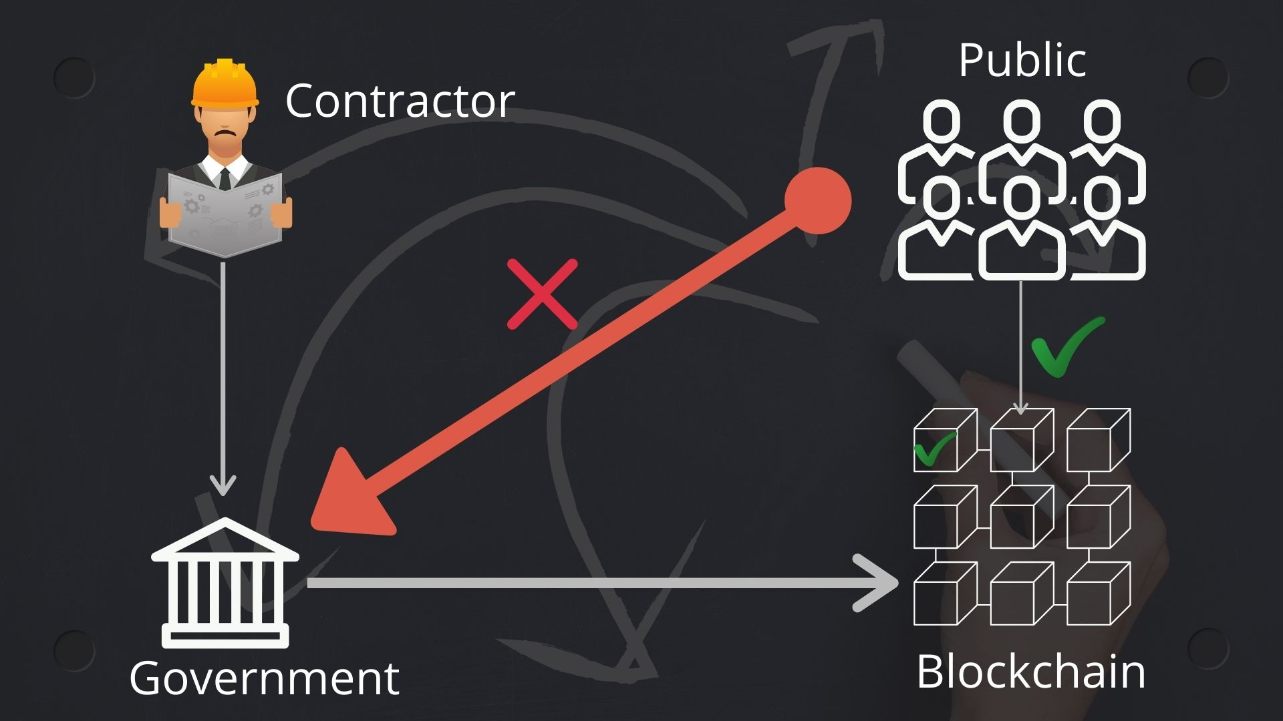

Slide 10
Solidity
React
Node.js
HTML and CSS
LANGUAGES USED

Slide 11
Ganache is a personal blockchain for rapid Ethereum application development. We can use Ganache across the entire development cycle; enabling us to develop, deploy, and test our dApps in a safe and deterministic environment.
GANACHE

Slide 12
MetaMask is software cryptocurrency wallet used to interact with the Ethereum blockchain. It allows users to access their Ethereum wallet through a browser extension or mobile app, which can then be used to interact with decentralized applications.
METAMASK

Slide 13
IPFS is a distributed system for storing and accessing files, websites, applications, and data. All hashes in IPFS are encoded as a MultiHash, a self-describing hash format. The actual hash function used depends on security requirements; “sha-256” is today’s default.
IPFS

Slide 14
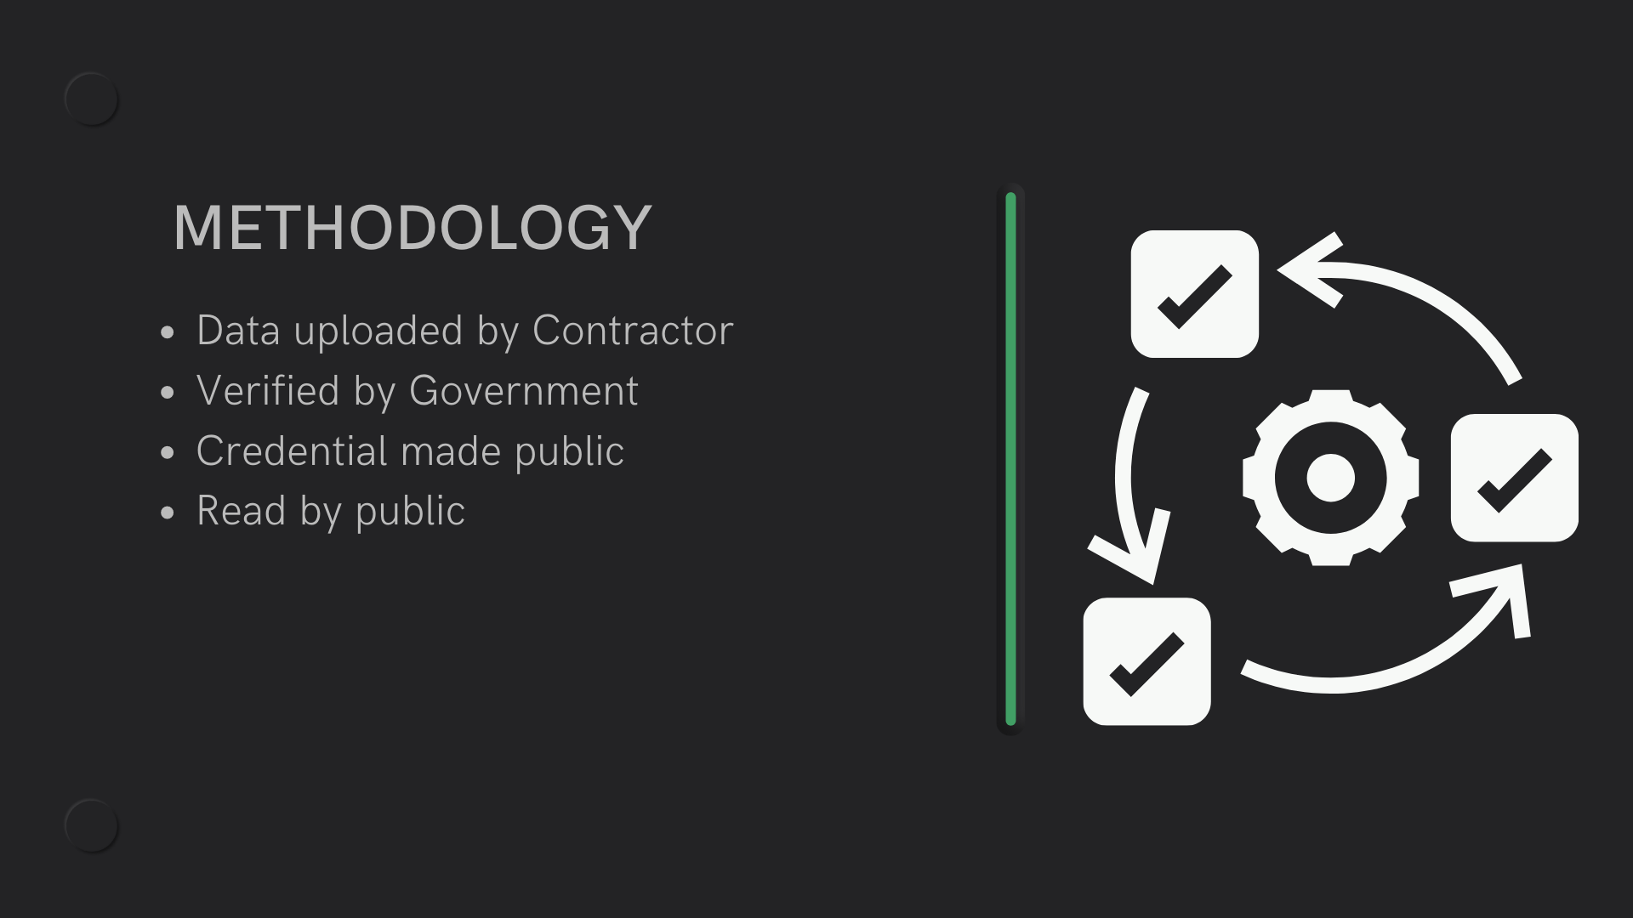

Slide 15
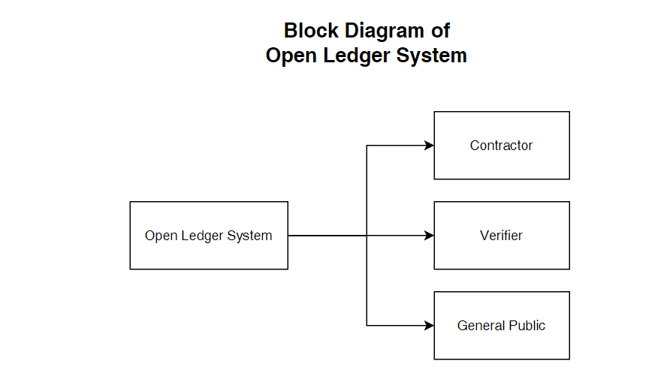

Slide 16
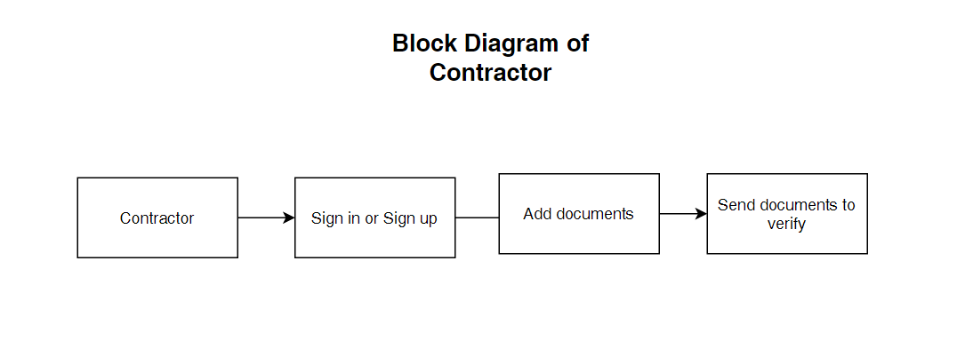

Slide 17
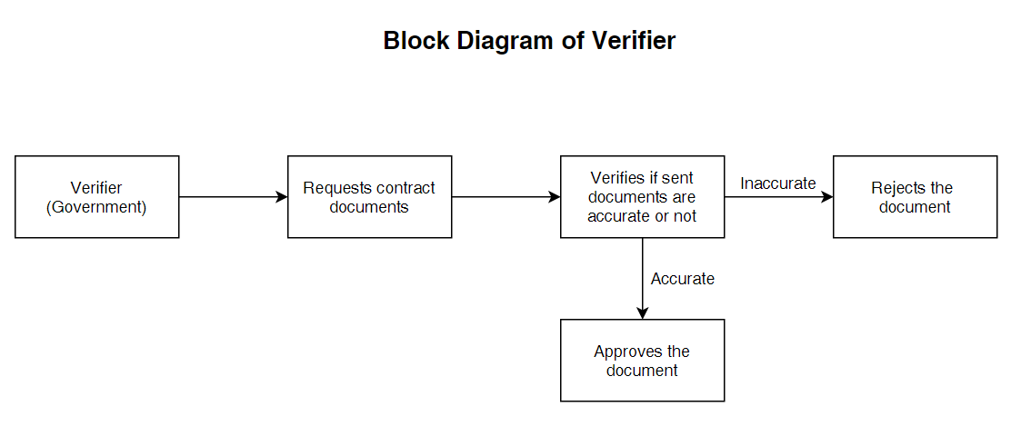

Slide 18
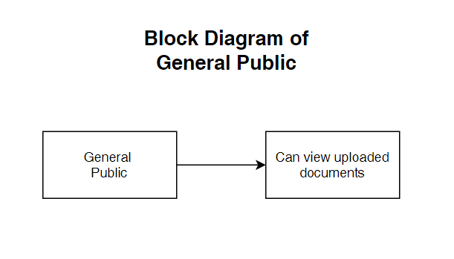

Slide 19


